Slide 1
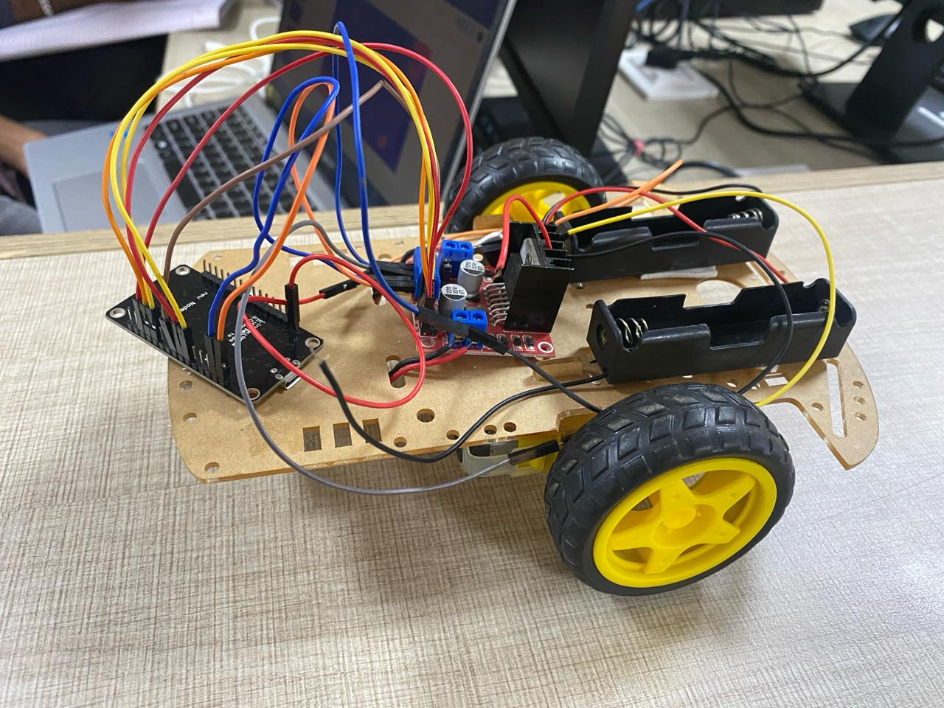


WIFI Trolley
BOT
Abinash S | Srivatsan N | Hari Prasad S

Slide 2
WIFI Trolley
BOT

Slide 3
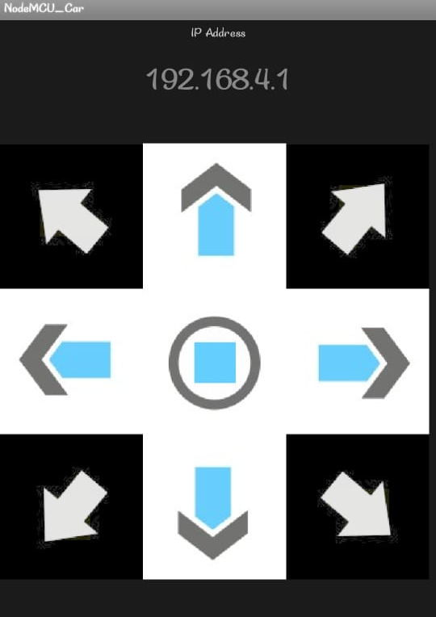
NodeMCU
Java

Slide 4
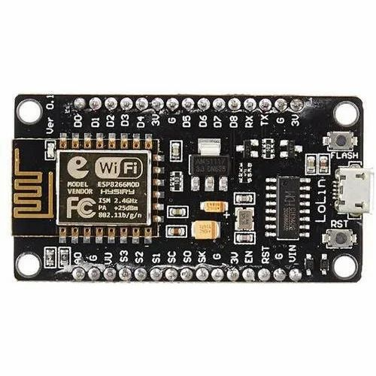
01
ESP8266

Slide 5
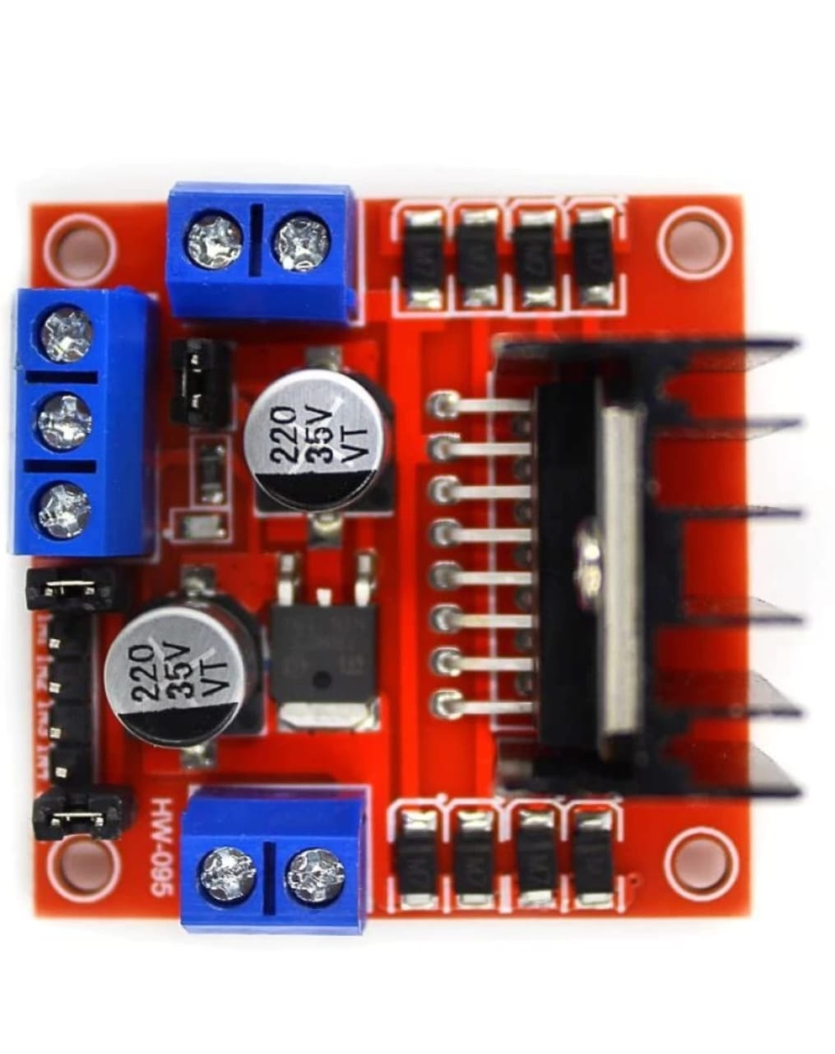
02
Motor Driver

Slide 6
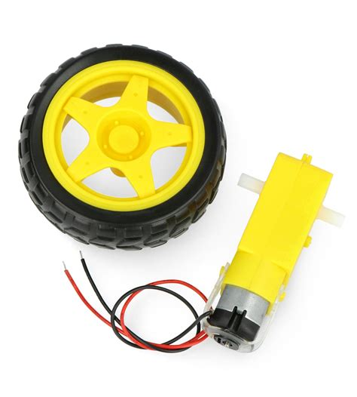
03
DC Geared Motor

Slide 7
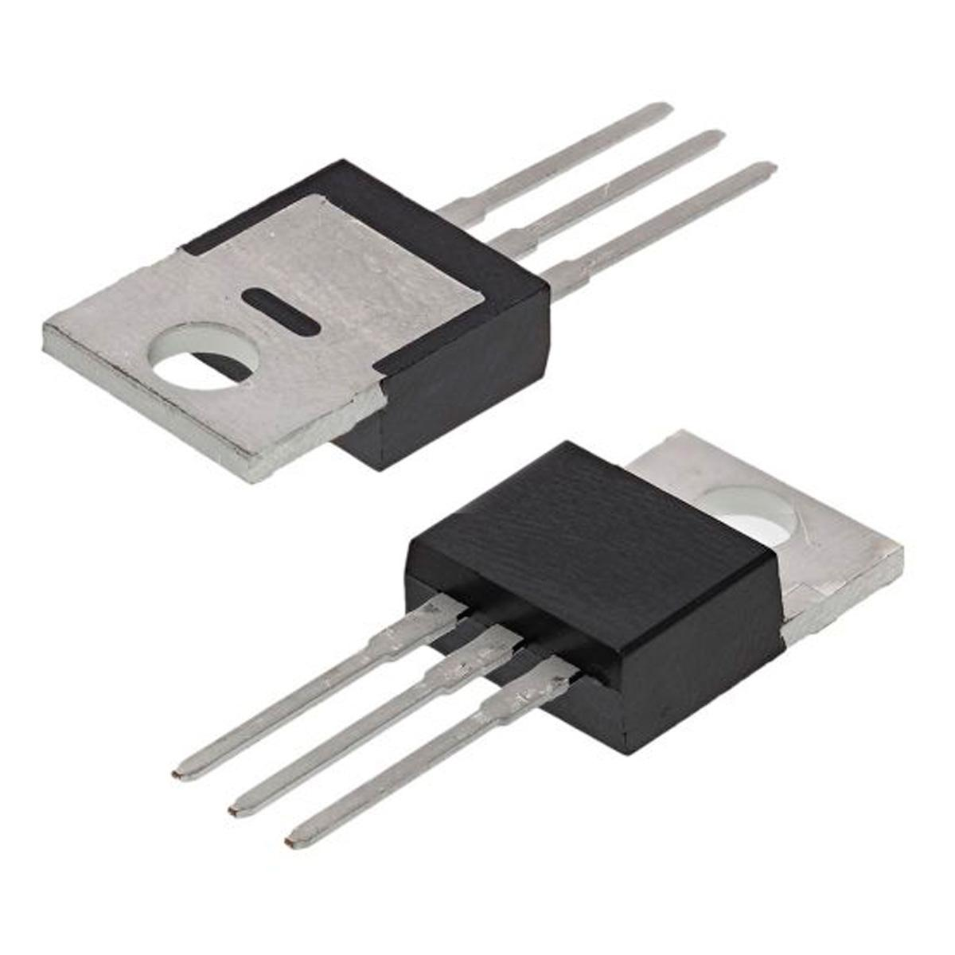
04
IC KA7805

Slide 8
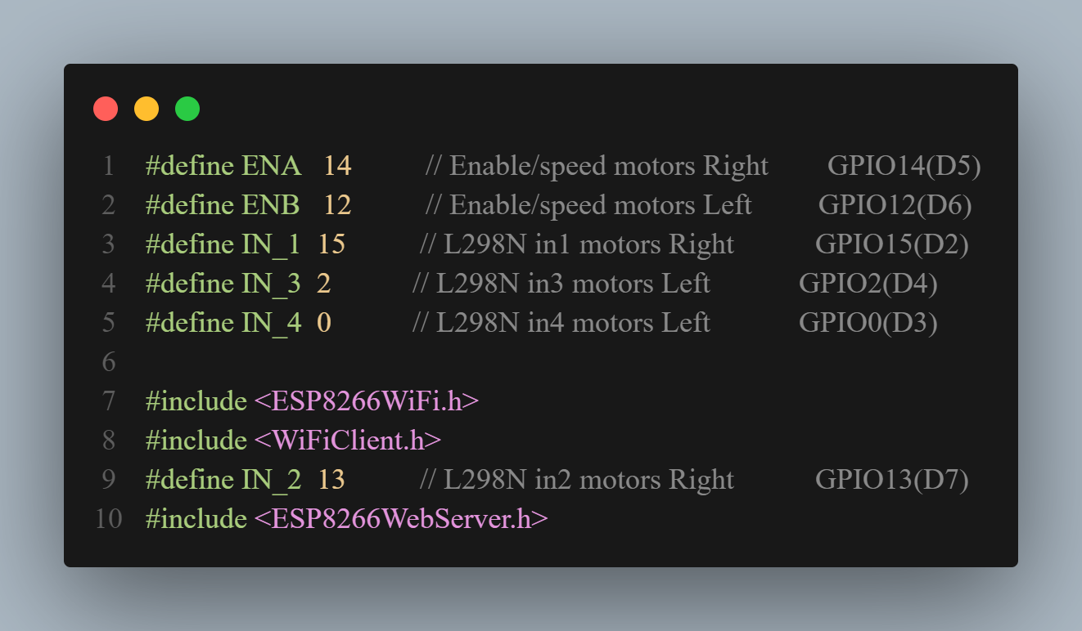

01

Slide 9
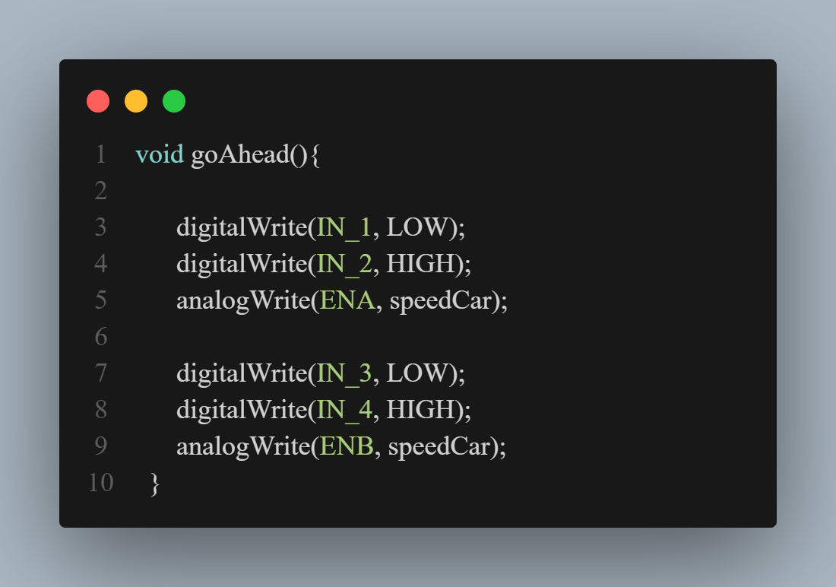
02

Slide 10
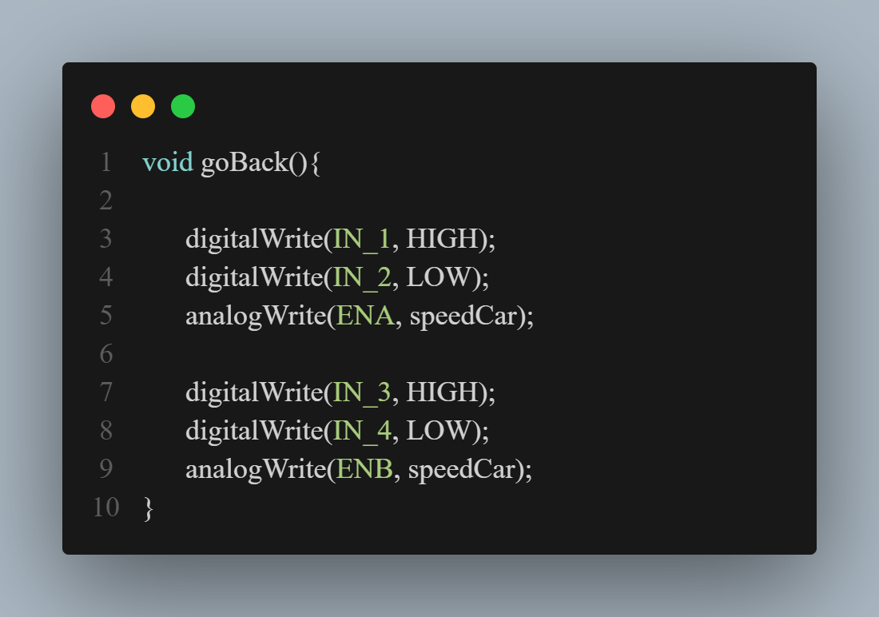
03

Slide 11

04

Slide 12

05

Slide 13

06

Slide 14
Project Done by
Abinash S
Srivatsan N
Hari Prasad S
III B. Tech CSE
III B. Tech CSE
III B. Tech CSE

Slide 15

Thanks!

